Slide 1
Fingerprint Spoof Detector Generalization
Paper Authors: Tarang Chugh; Anil K. Jain
IEEE Transactions on Information Forensics and Security
Group Members: Noah Dunn, Steven Yu

Slide 2
1. Introduction

Slide 3
1. Introduction
1.1 The Physical Realm of Cybersecurity
1.2 Understanding Physical Attacks
1.3 Modern Attacks for Modern Cybersecurity
1.4 Understanding Biometrics and Biometric Attacks
1.5 Fingerprint Spoofing Attacks

Slide 4
1. Introduction
1.1 The Physical Realm of Cybersecurity
1.2 Understanding Physical Attacks
1.3 Modern Attacks for Modern Cybersecurity
1.4 Understanding Biometrics and Biometric Attacks
1.5 Fingerprint Spoofing Attacks

Slide 5
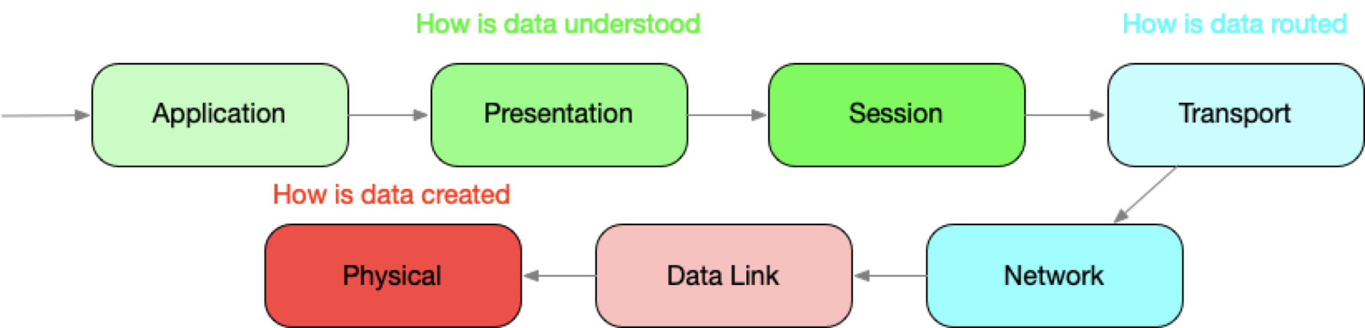
1.1 The Physical Realm of Cybersecurity
Open Systems Interconnection (OSI) Stack

Slide 6
1. Introduction
1.1 The Physical Realm of Cybersecurity
1.2 Understanding Physical Attacks
1.3 Modern Attacks for Modern Cybersecurity
1.4 Understanding Biometrics and Biometric Attacks
1.5 Fingerprint Spoofing Attacks

Slide 7
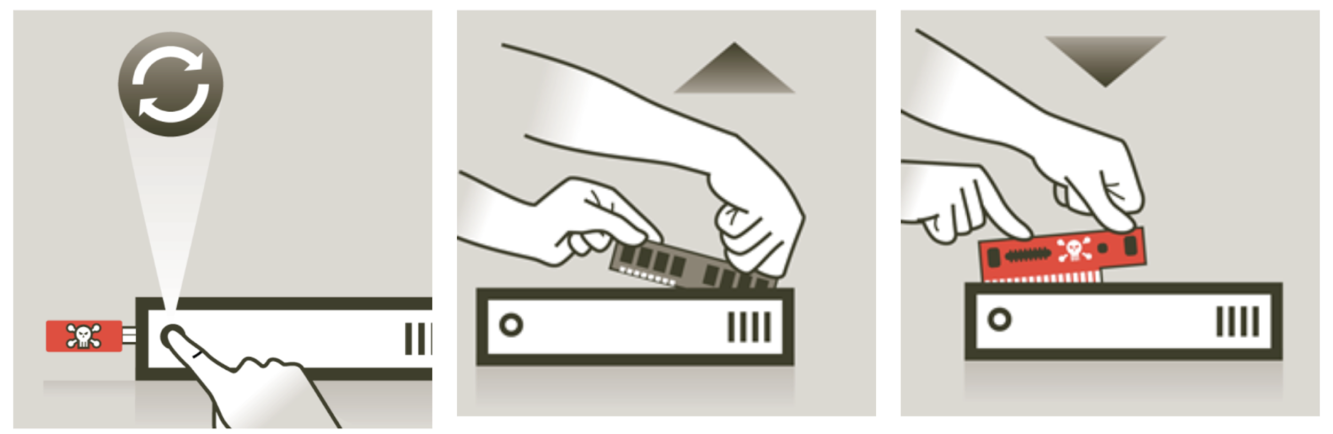
1.2 Understanding Physical Attacks
Physical Attacks

Slide 8
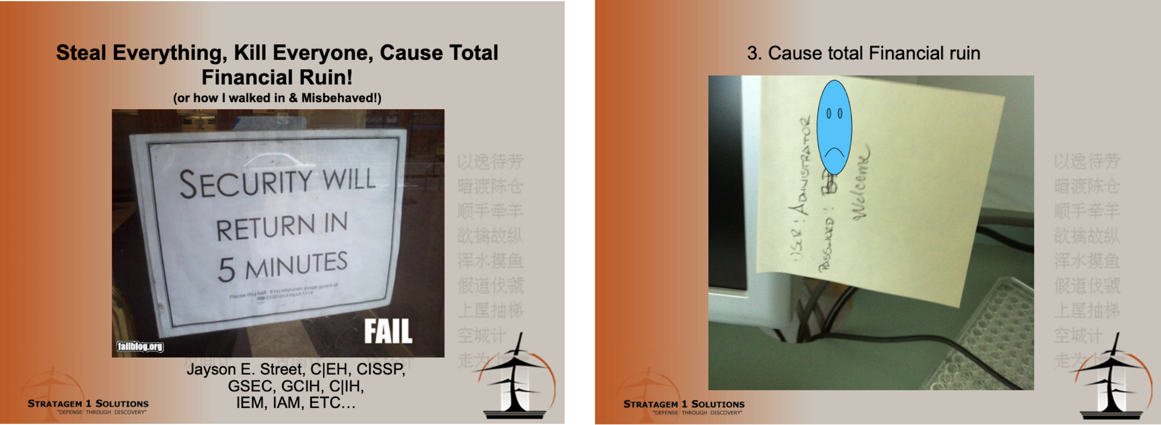
1.2 Understanding Physical Attacks
https://www.defcon.org/images/defcon-19/dc-19-presentations/Street/DEFCON-19-Street-Steal-Everything.pdf
https://www.youtube.com/watch?v=JsVtHqICeKE

Slide 9
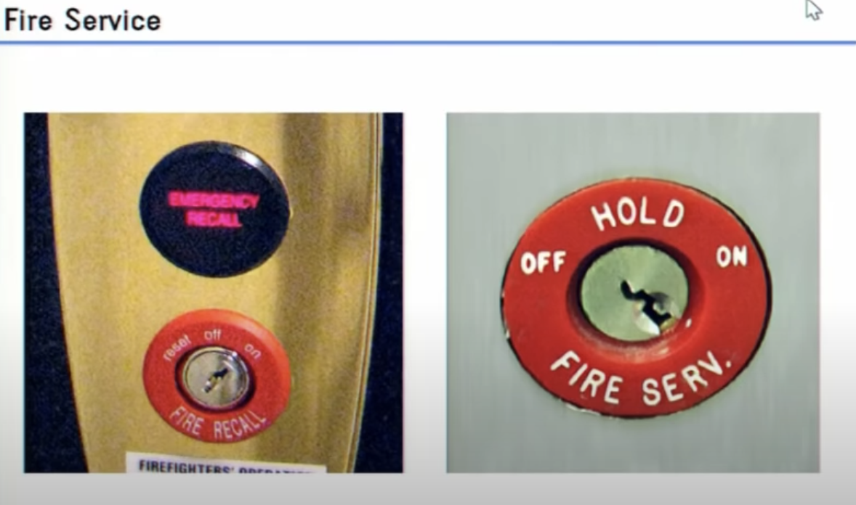
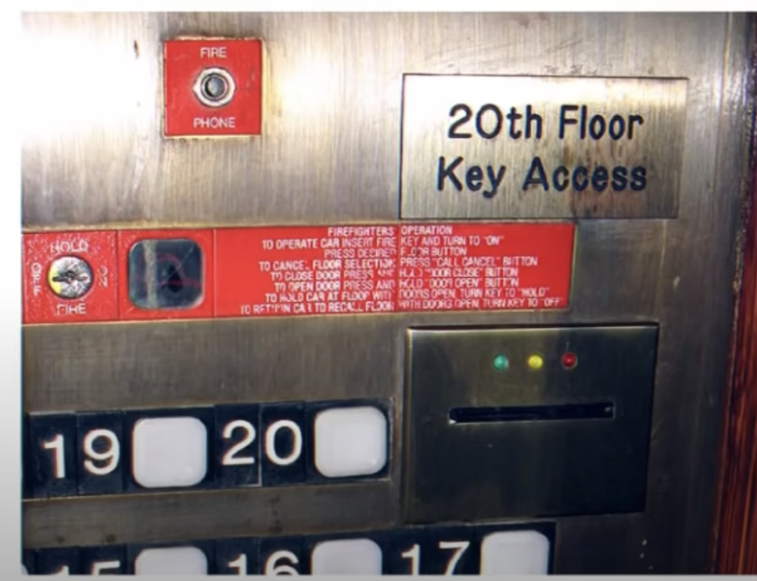
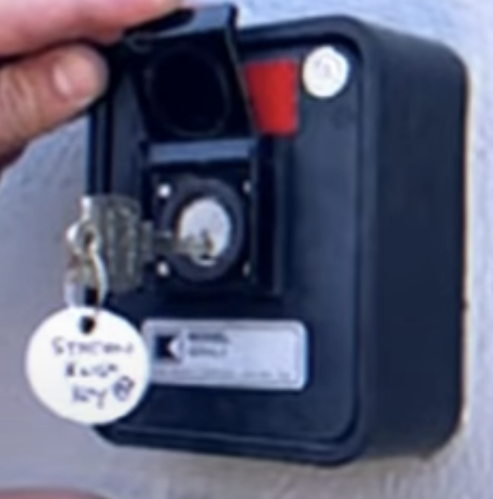
1.2 Understanding Physical Attacks
https://www.defcon.org/images/defcon-19/dc-19-presentations/Street/DEFCON-19-Street-Steal-Everything.pdf
https://www.youtube.com/watch?v=JsVtHqICeKE

Slide 10
DEFCON Conference

Slide 11
1. Introduction
1.1 The Physical Realm of Cybersecurity
1.2 Understanding Physical Attacks
1.3 Modern Attacks for Modern Cybersecurity
1.4 Understanding Biometrics and Biometric Attacks
1.5 Fingerprint Spoofing Attacks

Slide 12

1.3 Modern Attacks for Modern Cybersecurity
...filled with desktop computers and mobile laptops that have access to company data..
..mobile users able to take their computers out of the facilities
David Hutter. Physical security and why it is important. volume Informa-tion Security Reading Room. SANS Institute, Jun 2016.
https://www.thesslstore.com/blog/the-top-9-cyber-security-threats-that-will-ruin-your-day/

Slide 13
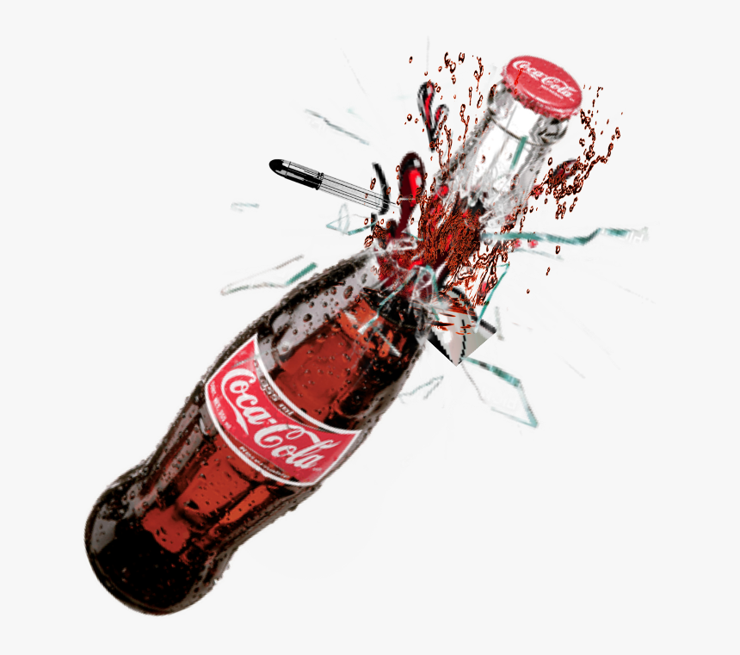
1.3 Modern Attacks for Modern Cybersecurity
Coke spokeswoman Ann Moore said the laptops were stolen by a former employee who had been assigned to maintain or dispose of equipment.
Coke said company policy requires laptops to be encrypted, but the stolen computers hadn't yet been encrypted.
https://www.wsj.com/articles/SB10001424052702304632204579341022959922200
https://www.thesslstore.com/blog/the-top-9-cyber-security-threats-that-will-ruin-your-day/

Slide 14
1. Introduction
1.1 The Physical Realm of Cybersecurity
1.2 Understanding Physical Attacks
1.3 Modern Attacks for Modern Cybersecurity
1.4 Understanding Biometrics and Biometric Attacks
1.5 Fingerprint Spoofing Attacks

Slide 15
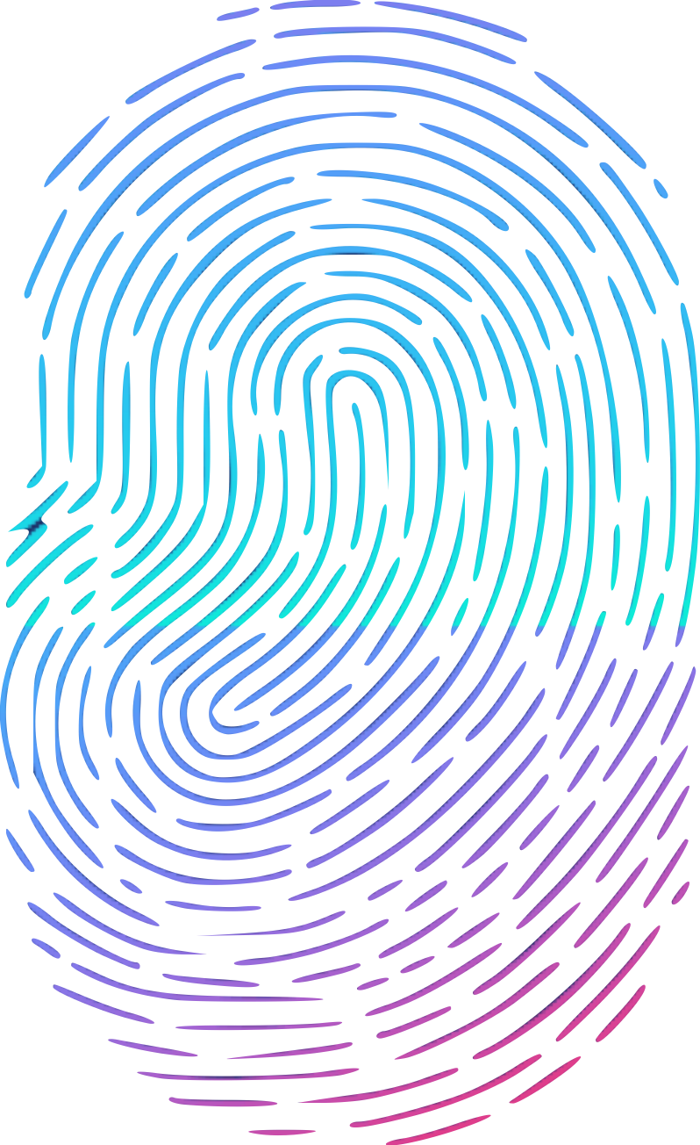
1.4 Understanding Biometrics and Biometric Attacks
AsNorton Security states, “Biometrics are a way to measure a person’s physical characteristics to verify their identity”
https://www.jdp.com/blog/single-national-criminal-database-myth-fbi-fingerprinting-works/

Slide 16
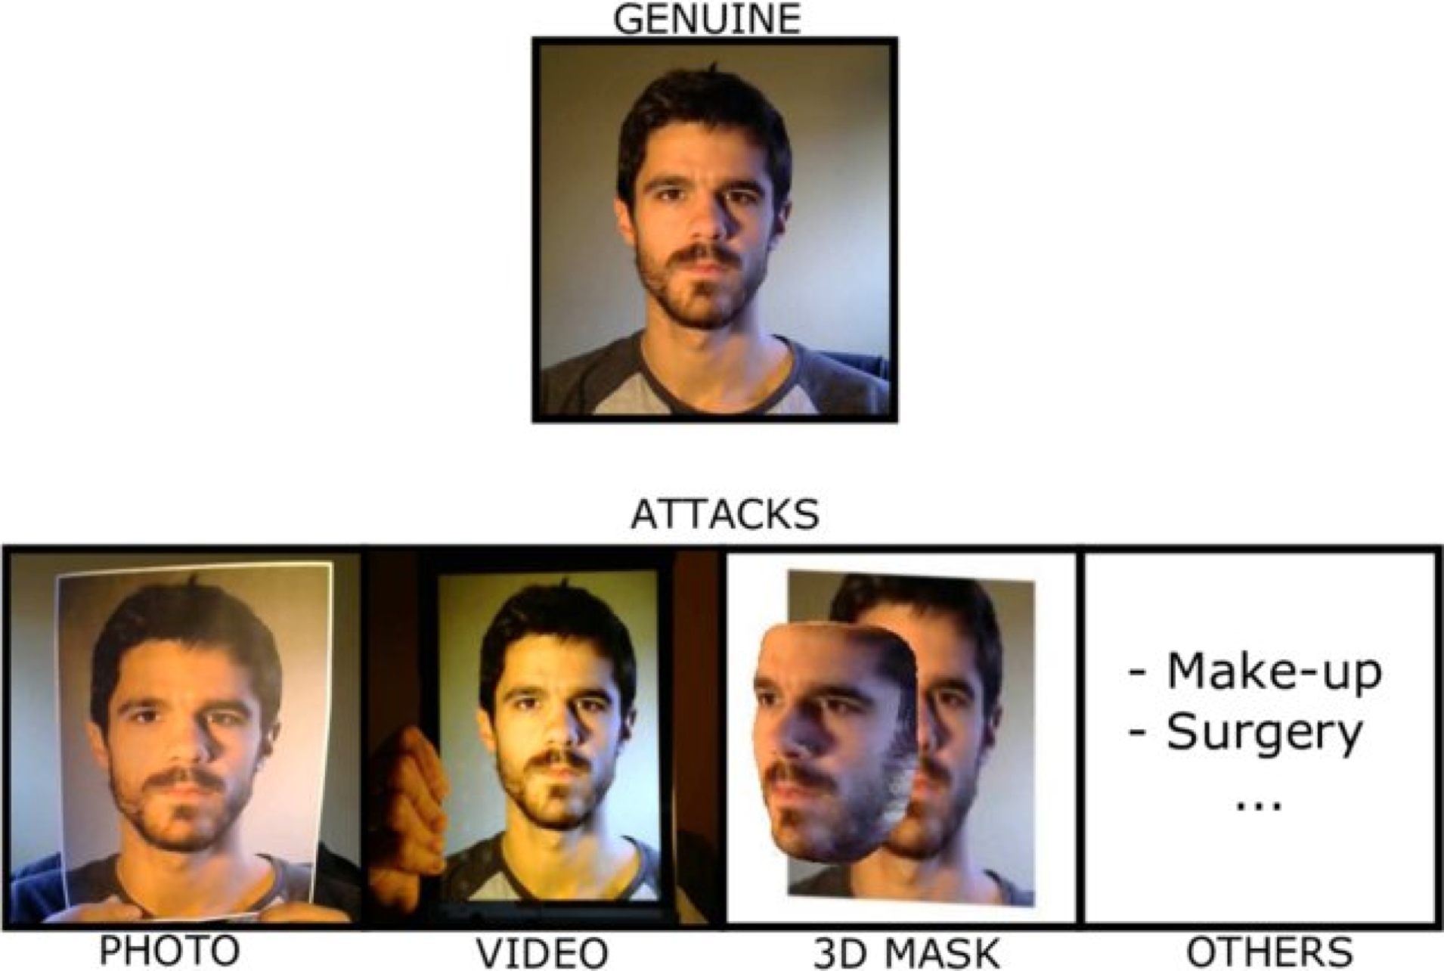
1.4 Understanding Biometrics and Biometric Attacks
Presentation Attack
An individual presents something that they should not possess
In order to act as though they are another person
Hernandez-Ortega, Javier & Fierrez, Julian & Morales, Aythami & Galbally, Javier. (2019). Introduction to Face Presentation Attack Detection. 10.1007/978-3-319-92627-8_9.

Slide 17
1. Introduction
1.1 The Physical Realm of Cybersecurity
1.2 Understanding Physical Attacks
1.3 Modern Attacks for Modern Cybersecurity
1.4 Understanding Biometrics and Biometric Attacks
1.5 Fingerprint Spoofing Attacks

Slide 18
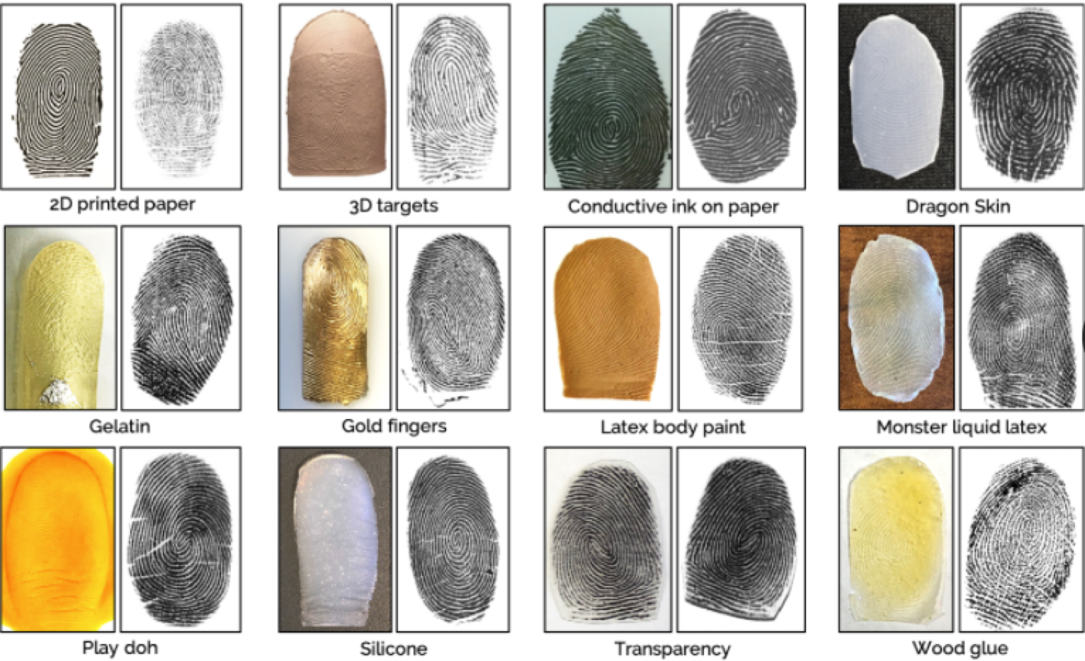
1.5 Fingerprint Spoofing Attacks
Using fingerprint of a known user to gain access to a known system
Fingerprint Spoof Detector Generalization

Slide 19
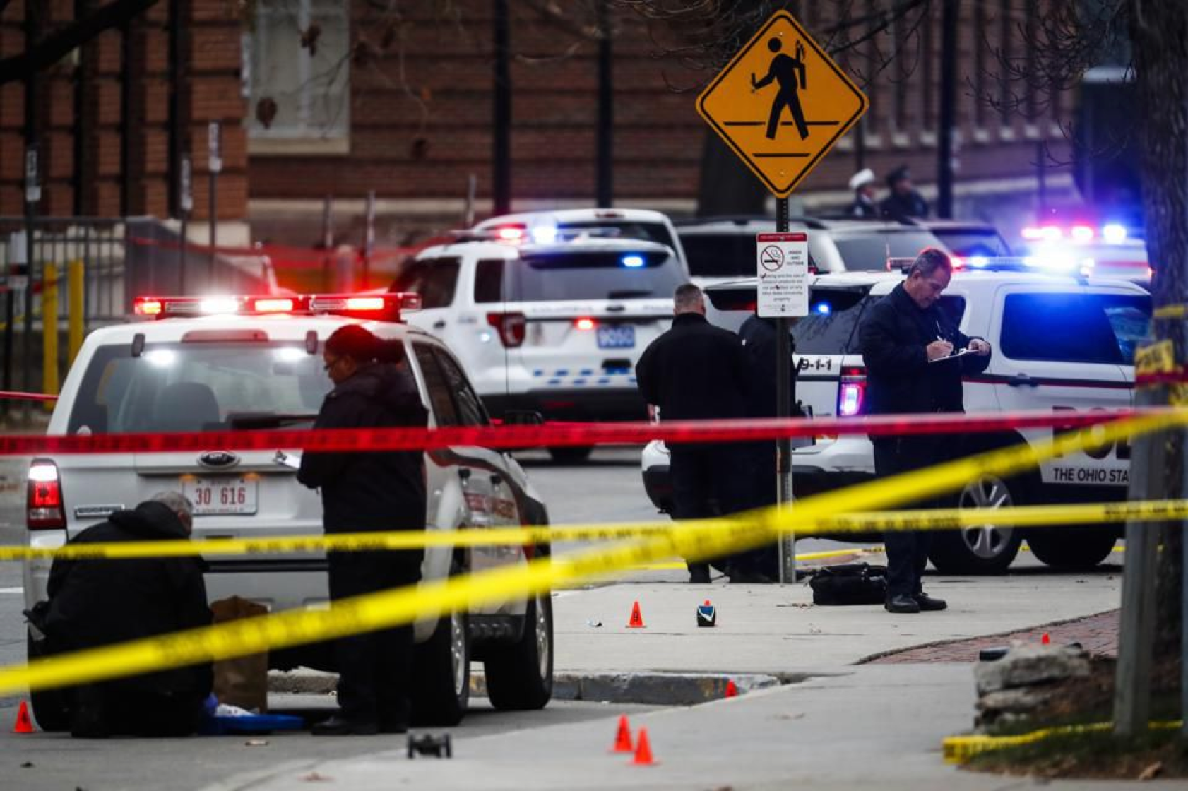
1.5 Fingerprint Spoofing Attacks
Liveness detection systems
iPhone
November 2016 - Ohio State University
‘Artan's lifeless fingerprint didn't unlock the device’
https://www.forbes.com/sites/thomasbrewster/2018/03/22/yes-cops-are-now-opening-iphones-with-dead-peoples-fingerprints/?sh=5fa9c06a393e

Slide 20
2. Previous work

Slide 21
2. Previous work
2.1 Origins of Fingerprint Spoofing Research
2.2 Modern Fingerprint Spoofing Research
2.3 Recent Anti-spoofing Results
2.4 Dataset

Slide 22
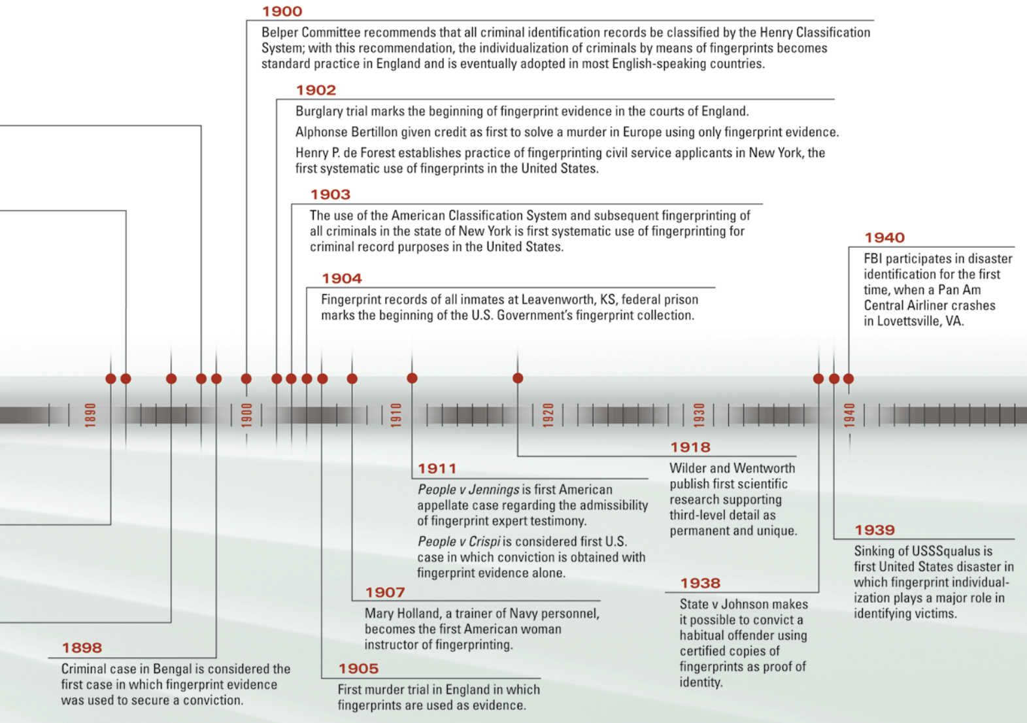
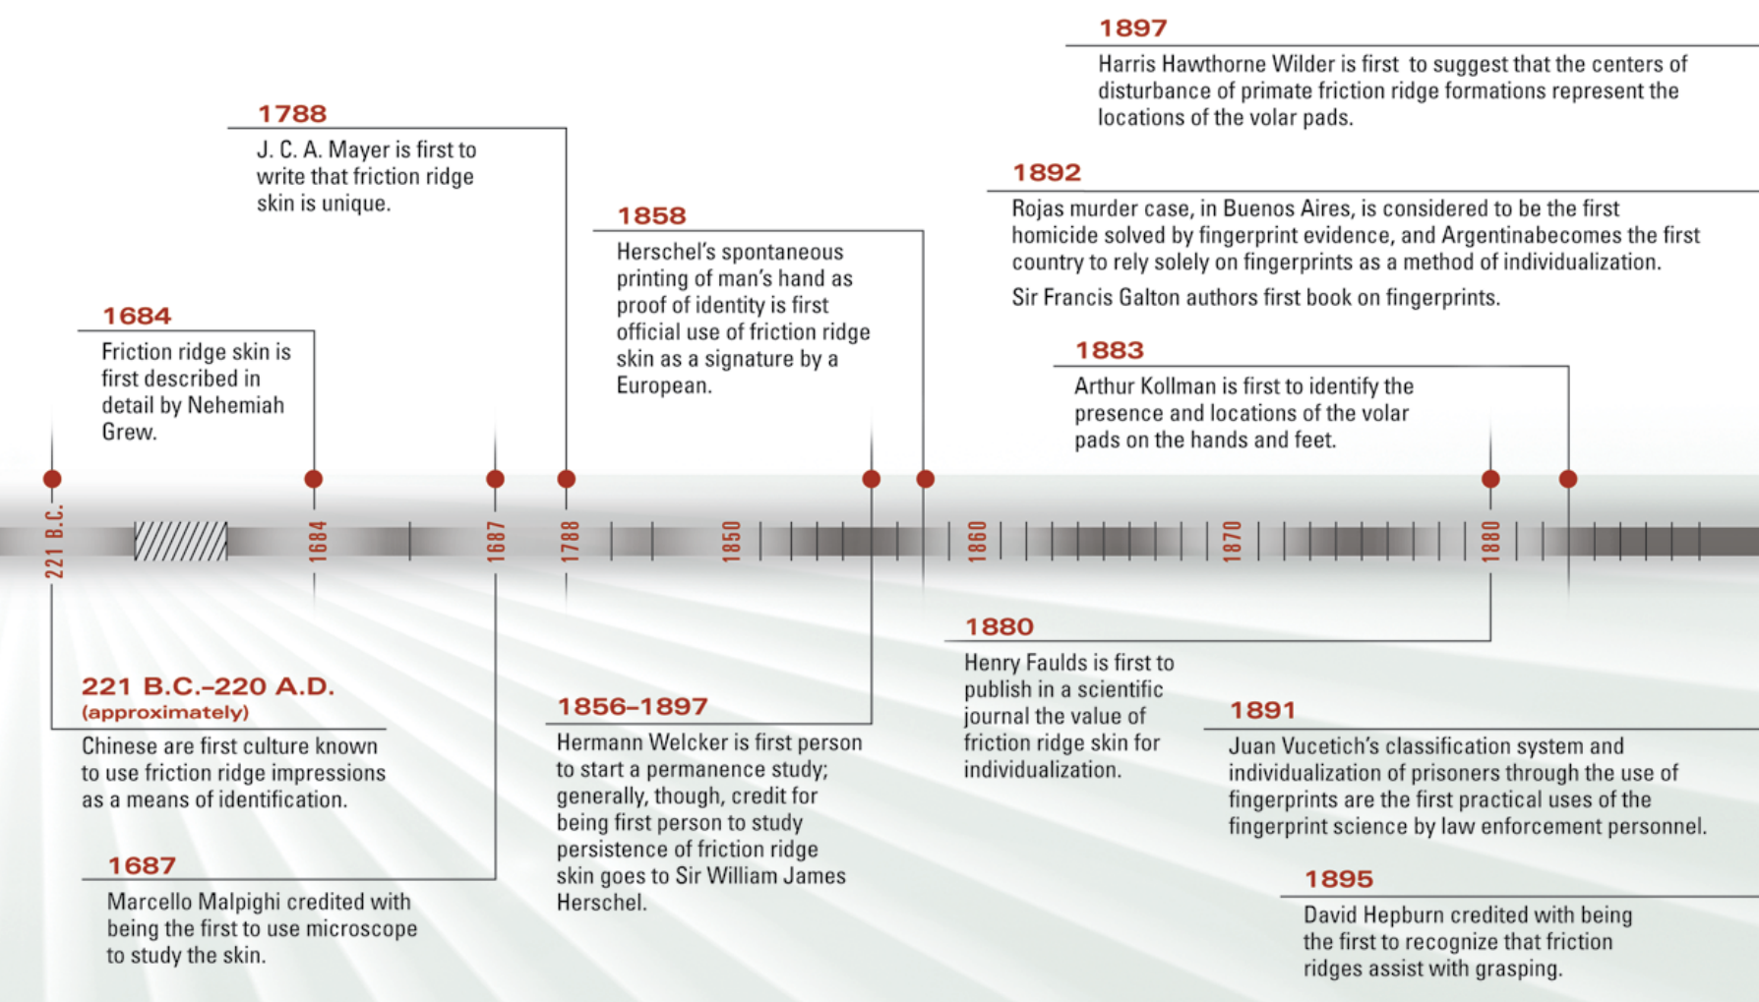
History (The Fingerprint Sourcebook By National Criminal Justice Reference Service)

Slide 23
Timeline
Liveness Detection
2000s
2005
2019
Spoof Fingerprints Detection
Slim-ResCNN

Slide 24
2. Previous work
2.1 Origins of Fingerprint Spoofing Research
2.2 Modern Fingerprint Spoofing Research
2.3 Recent Anti-spoofing Results
2.4 Dataset

Slide 25
2.1 Origins of Fingerprint Spoofing Research
Matsumoto et al. (2002):
Fake fingerprints could trick automated sensor
Shuckers et al. (2002):
Detecting these kind of spoofs;
Different scanners’ performance;
Anti-spoofing techniques

Slide 26
2. Previous work
2.1 Origins of Fingerprint Spoofing Research
2.2 Modern Fingerprint Spoofing Research
2.3 Recent Anti-spoofing Results
2.4 Dataset

Slide 27
2.2 Modern Fingerprint Spoofing Research
Reddy et al. (2008):
Liveness detection - Oximetry
Kumar et al.(2012):
Finger veins
Gragnaniello et al.(2013):
Machine Learning Technique

Slide 28
2. Previous work
2.1 Origins of Fingerprint Spoofing Research
2.2 Modern Fingerprint Spoofing Research
2.3 Recent Anti-spoofing Results
2.4 Dataset

Slide 29
2.3 Recent Anti-spoofing Results
State of the art spoof detectors:
Fingerprint Spoof Buster
Deep convolutional neural network
Slim-ResCNN
A Deep Residual Convolutional Neural Network

Slide 30
2. Previous work
2.1 Origins of Fingerprint Spoofing Research
2.2 Modern Fingerprint Spoofing Research
2.3 Recent Anti-spoofing Results
2.4 Dataset

Slide 31
2.4 Dataset
Dataset | Sensor | Technology
LivDet 2011 | Biometrika | Optical
 | Sagem | Optical
 | Digital Persona | Optical
 | Italdata | Optical
LivDet 2013 | Biometrika | Optical
 | CrossMatch | Optical
 | Swipe | Optical
 | Italdata | Optical
Sensor: Veridicom, Precise, Ethentica, Biometrika….
Technology: Capacitive, Electro-optical, Optical
Dataset | Sensor | Technology
LivDet 2015 | Green Bit | Optical
 | Biometrika | Optical
 | Digital Persona | Optical
 | Crossmatch | Optical
MSU | Identix | Optical

Slide 32
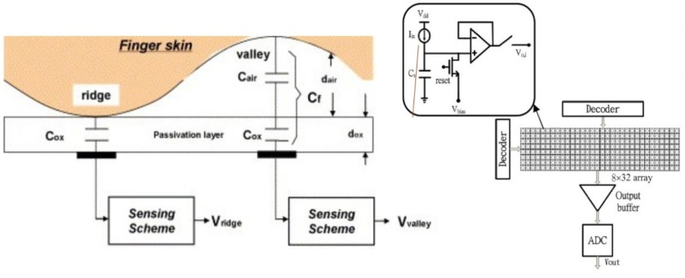
2.4 Dataset - Addon
Technology: Capacitive
https://www.androidauthority.com/how-fingerprint-scanners-work-670934/

Slide 33
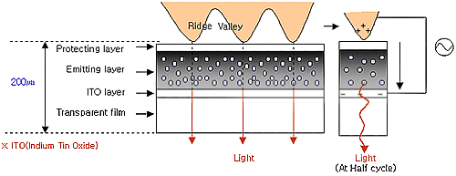
2.4 Dataset - Addon
Technology: Electro-optical
https://www.androidauthority.com/how-fingerprint-scanners-work-670934/

Slide 34
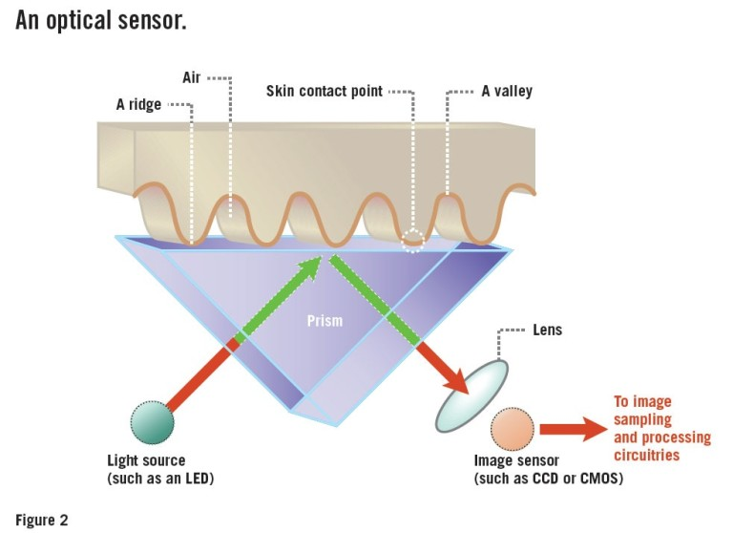
2.4 Dataset - Addon
Technology: Optical
https://www.androidauthority.com/how-fingerprint-scanners-work-670934/

Slide 35
3. Main results

Slide 36
3. Main results
3.1 UMG Results Overview
3.2 UMG Input Data
3.3 UMG Performance Results

Slide 37
3. Main results
3.1 UMG Results Overview
3.2 UMG Input Data
3.3 UMG Performance Results

Slide 38
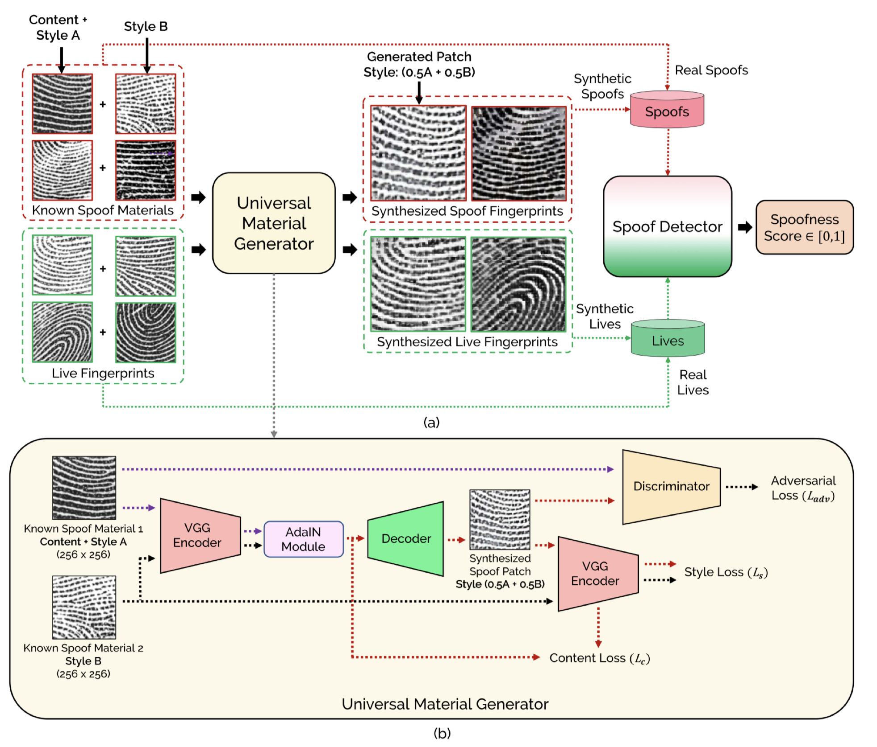
3.1 UMG Results Overview
Universal Material Generator (UMG)
Taking the texture features of given, known, fingerprint images + spoofs and synthesizing new materials to be added to the existing database
Training and testing against materials not seen before

Slide 39
3. Main results
3.1 UMG Results Overview
3.2 UMG Input Data
3.3 UMG Performance Results

Slide 40

3.2 UMG Input Data
MSU Fingerprint Presentation Attack Database
5,743 live images
4,912 spoof images
LivDet database (2017)
7,500 images
three different types of fingerprint readers
additional spoof materials

Slide 41
3. Main results
3.1 UMG Results Overview
3.2 UMG Input Data
3.3 UMG Performance Results

Slide 42
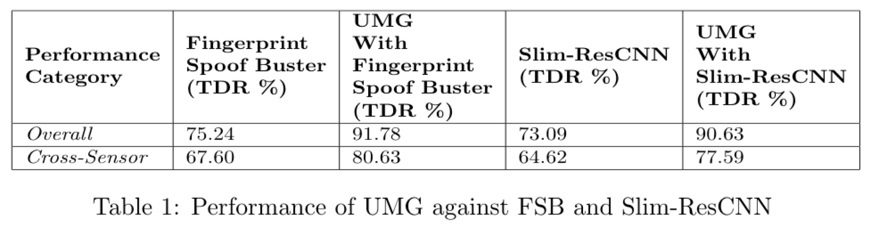
3.3 UMG Performance Results

Slide 43
4. Techniques

Slide 44
4. Techniques
4.1 Overview of the System Design
4.2 Training the UMG Using Known Spoofs
4.3 Generating Synthetic Spoof Images using UMG Wrapper
4.4 Validating Synthetic Spoof Images
4.5 Training the Spoof Detector on Synthetic Images

Slide 45
4. Techniques
4.1 Overview of the System Design
4.2 Training the UMG Using Known Spoofs
4.3 Generating Synthetic Spoof Images using UMG Wrapper
4.4 Validating Synthetic Spoof Images
4.5 Training the Spoof Detector on Synthetic Images

Slide 46
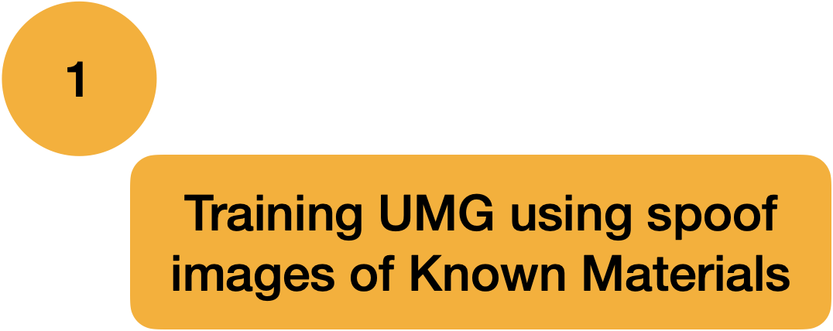
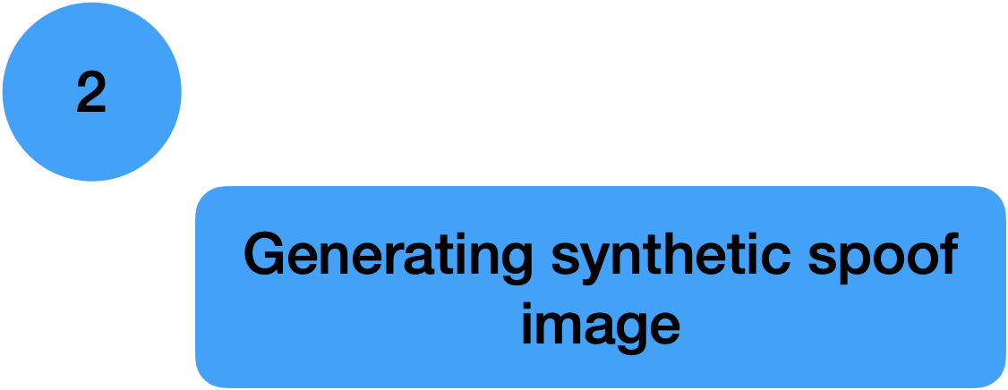
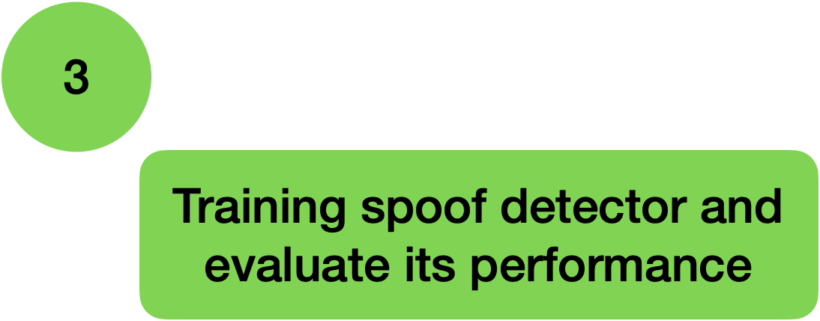
4.1 Overview of the System Design

Slide 47
4. Techniques
4.1 Overview of the System Design
4.2 Training the UMG Using Known Spoofs
4.3 Generating Synthetic Spoof Images using UMG Wrapper
4.4 Validating Synthetic Spoof Images
4.5 Training the Spoof Detector on Synthetic Images

Slide 48

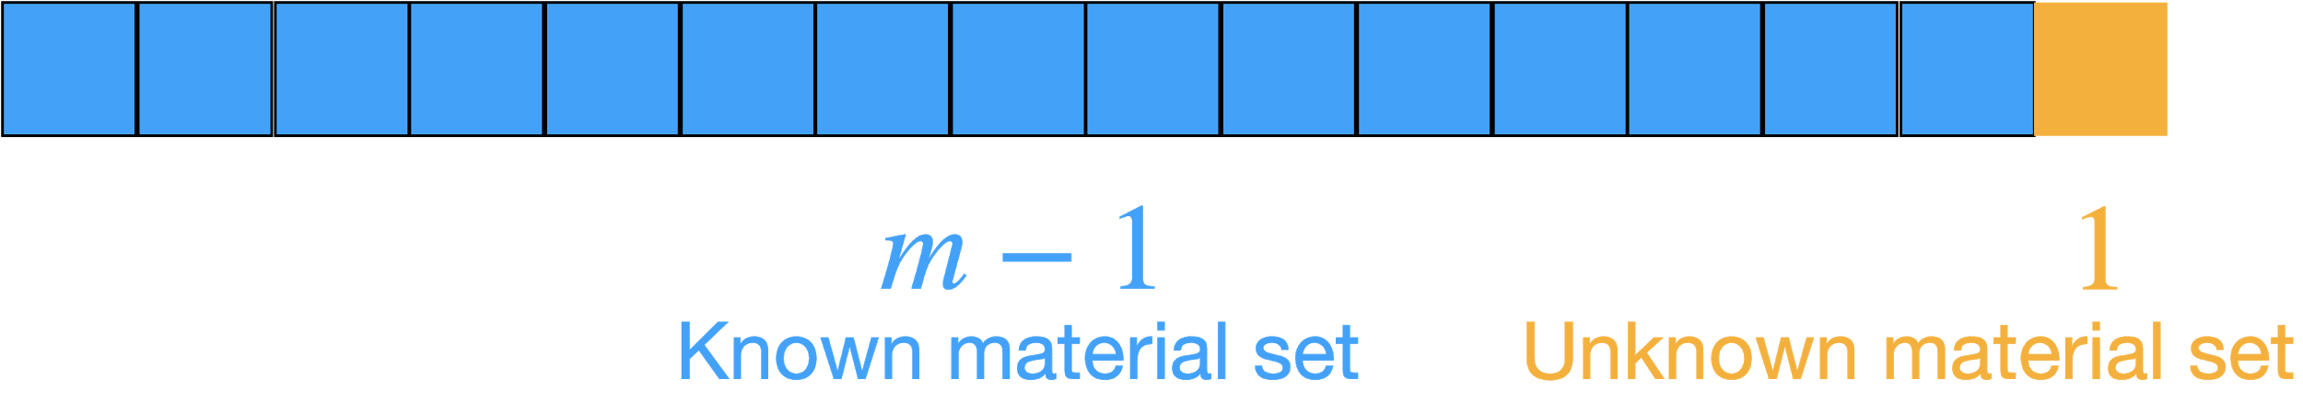
4.2 Training the UMG Using Known Spoofs

Slide 49
4. Techniques
4.1 Overview of the System Design
4.2 Training the UMG Using Known Spoofs
4.3 Generating Synthetic Spoof Images using UMG Wrapper
4.4 Validating Synthetic Spoof Images
4.5 Training the Spoof Detector on Synthetic Images

Slide 50

4.3 Generating Synthetic Spoof Images using UMG Wrapper

Slide 51
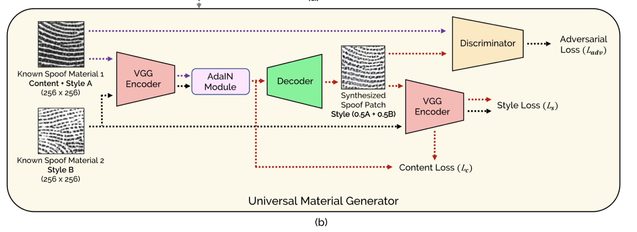
4.3 Generating Synthetic Spoof Images using UMG Wrapper
Two Known Inputs

Slide 52
4.3 Generating Synthetic Spoof Images using UMG Wrapper
f(·) = VGG-19 Neural Net
All possible outputs of this function are called f(c)

Slide 53
4.3 Generating Synthetic Spoof Images using UMG Wrapper
All possible outputs of this function are called f(c)

Slide 54
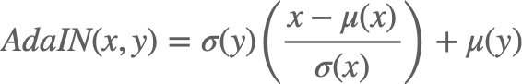
4.3 Generating Synthetic Spoof Images using UMG Wrapper
AdaIN is shorthand for “Adaptive Instance Norm”

Slide 55

4.3 Generating Synthetic Spoof Images using UMG Wrapper
Alpha is set to 0.5 in these Experiments (Source = 0, New = 1)

Slide 56
4.3 Generating Synthetic Spoof Images using UMG Wrapper
The Synthesized Patch!

Slide 57
4. Techniques
4.1 Overview of the System Design
4.2 Training the UMG Using Known Spoofs
4.3 Generating Synthetic Spoof Images using UMG Wrapper
4.4 Validating Synthetic Spoof Images
4.5 Training the Spoof Detector on Synthetic Images

Slide 58

4.3 Generating Synthetic Spoof Images using UMG Wrapper
4 Parameters created from VGG-19, Used for Loss Function

Slide 59
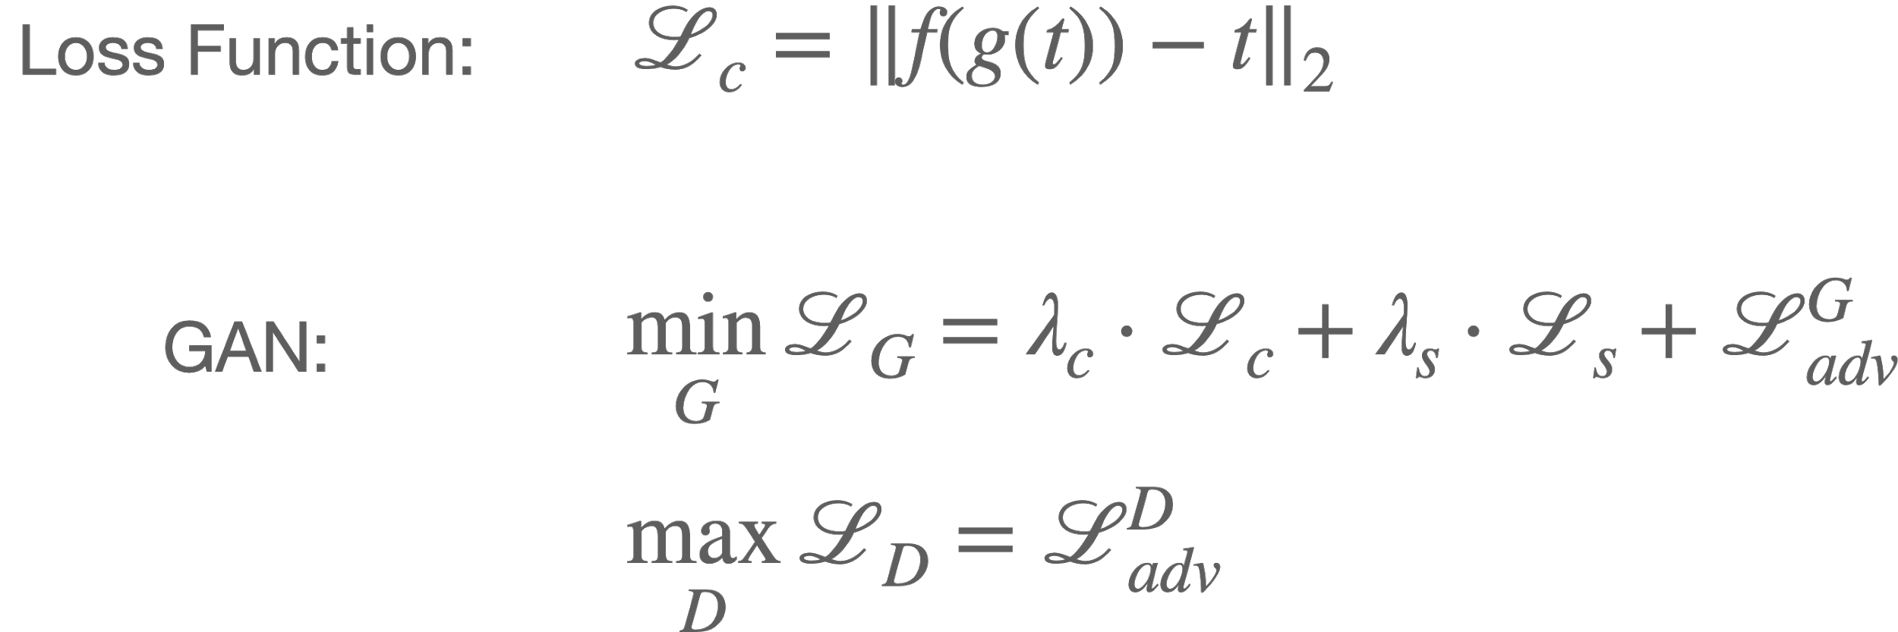
4.4 Validating Synthetic Spoof Images
GAN (Generative Adversarial Network) is similar to the Adversary ‘game’ in Cryptography

Slide 60
4. Techniques
4.1 Overview of the System Design
4.2 Training the UMG Using Known Spoofs
4.3 Generating Synthetic Spoof Images using UMG Wrapper
4.4 Validating Synthetic Spoof Images
4.5 Training the Spoof Detector on Synthetic Images

Slide 61
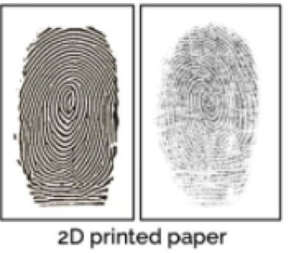
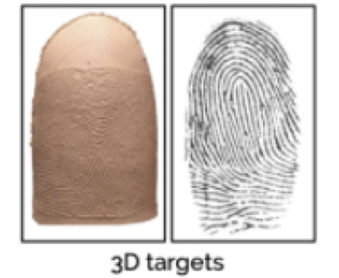
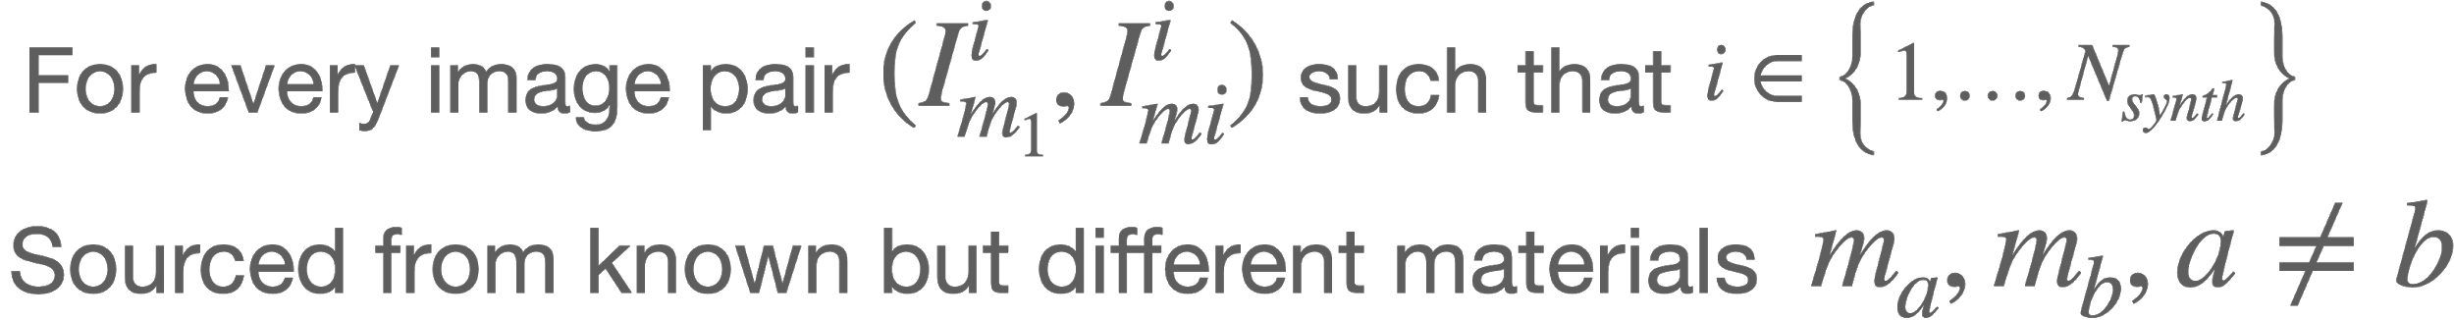
4.5 Training the Spoof Detector on Synthetic Images
MIX AND TEST!

Slide 62
Discussion

Slide 63
Noah’s Thoughts
The content of the paper possessed a high amount of integrity, and the results made sense given how the authors worked through their pipelines
My biggest gripes are on the lack of explanation of the formulas and the individual symbols in each formula. It made it very difficult to read and understand exactly what was occuring, which is why my explanation was kept at a very high level.
In addition, the authors do not clue the reader in to any of their individual computer science techniques that they used when constructing or building the UMG. Vocabulary like ‘Patches’ or ‘Features’ are not contextualized with any data structures.
The improvements in the results were great

Slide 64
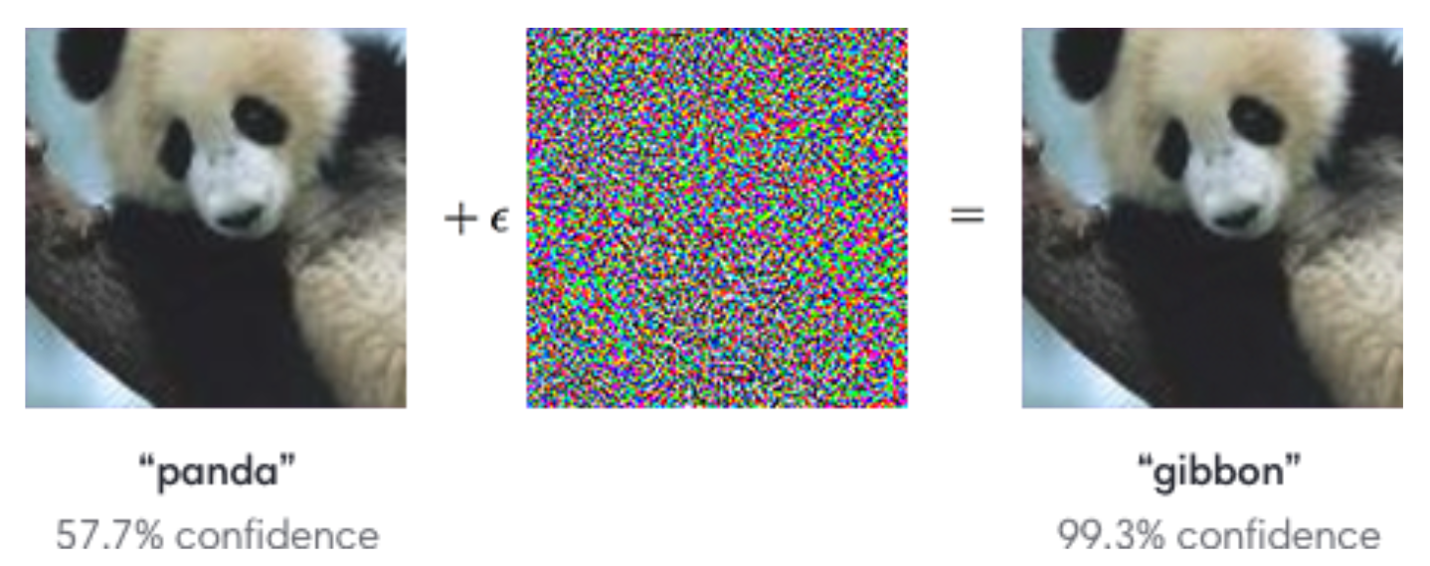
Steven’s Thoughts
Adversarial Attack

Slide 65
2.4 Dataset
Dataset | Sensor | Technology
LivDet 2011 | Biometrika | Optical
 | Sagem | Optical
 | Digital Persona | Optical
 | Italdata | Optical
LivDet 2013 | Biometrika | Optical
 | CrossMatch | Optical
 | Swipe | Optical
 | Italdata | Optical
Sensor: Veridicom, Precise, Ethentica, Biometrika….
Technology: Capacitive, Electro-optical, Optical
Dataset | Sensor | Technology
LivDet 2015 | Green Bit | Optical
 | Biometrika | Optical
 | Digital Persona | Optical
 | Crossmatch | Optical
MSU | Identix | Optical

Slide 66
Q&A

